Slide 1
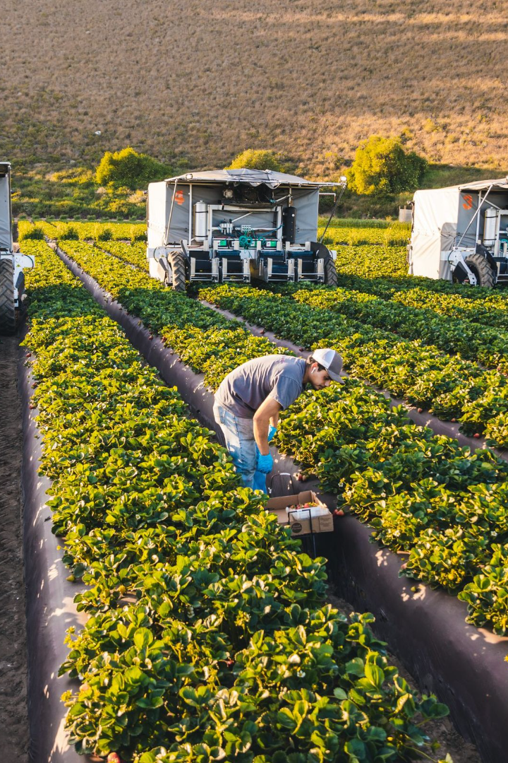

KrishiKart
Welcome to KrishiKart, your one-stop-shop for all your farming needs. Our mission is to make farming easier and more profitable for farmers around the world.
Team :
Suraj Jagdale
Krishna Kant Srivastava
Mentors :
Mr. Harshal Sir
Mrs. Monika Ma'am

Slide 2
Introduction
KrishiKart is a pioneering solution designed to streamline agricultural transactions and facilitate connections between farmers and buyers. Our objective is to create a user-friendly platform that simplifies the process of buying and selling agricultural products.
With KrishiKart, farmers and buyers can seamlessly interact, enhancing convenience for both parties. Our system aims to revolutionize the agricultural exchange, making it easier than ever to access and purchase high-quality products directly from farmers.
Experience a modern way of agricultural transactions with KrishiKart – where farmers meet buyers, and convenience meets quality.

Slide 3

About KrishiKart
1
Empowering Farmers 🌱
2
Simple and User-Friendly 🤖
3
Global Reach 🌍
We are dedicated to connecting farmers from around the world with buyers to promote sustainability and ethical farming practices on a global scale.
KrishiKart is an online platform that connects farmers directly with buyers, eliminating middlemen and increasing profits for farmers.
Our platform is easy to use and accessible from anywhere with an internet connection, making it easy for farmers to sell their products and buyers to purchase them.

Slide 4
How KrishiKart Works
1
2
3
Registration
Listings
Transactions
Sign up for KrishiKart and create your account as a farmer or buyer.
As a farmer, list your products and set your prices. As a buyer, browse available listings and add products to your cart.
Finalize your transactions through the platform, eliminating any need for middlemen or in-person meetings.

Slide 5
Abstract
The system is implemented using a 3-tier approach, with a backend database, a middle tier of spring boot server application, and the react front end client accessed through a web browser. KrishiKart uses multi-tier MVC architecture, server and client-side scripting techniques, and implementation technologies such as Java(OOP), Spring Boot, Hibernate, BOOTSTRAP, HTML5, CSS, ReactJS, relational databases (MySQL) etc.

Slide 6
Purpose
The primary purpose of KrishiKart is to revolutionize the agricultural sector by providing a digital platform that serves as a bridge between farmers and buyers. This platform aims to simplify and enhance the process of buying and selling agricultural products, ultimately benefiting both farmers and buyers. By creating a convenient and efficient space for transactions, KrishiKart seeks to empower farmers, expand market reach, and ensure that buyers have access to a diverse range of high-quality agricultural products. Through this purpose, KrishiKart aims to contribute to the growth and modernization of India's agricultural ecosystem.

Slide 7
Scope
KrishiKart aims to develop a user-friendly digital platform connecting farmers and buyers for efficient agricultural transactions. The scope includes creating profiles, listing products, secure transactions, order management, and market expansion. This platform will modernize agricultural exchange, enhancing convenience and transparency for both parties involved.

Slide 8
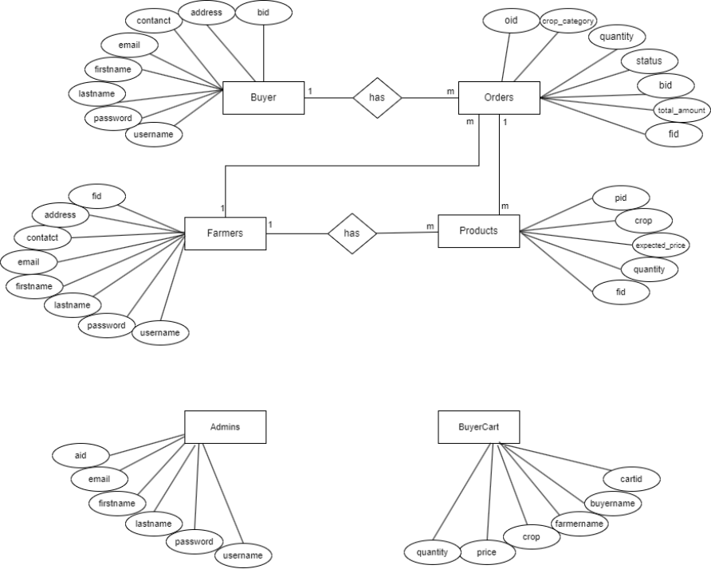
ER Diagram

Slide 9
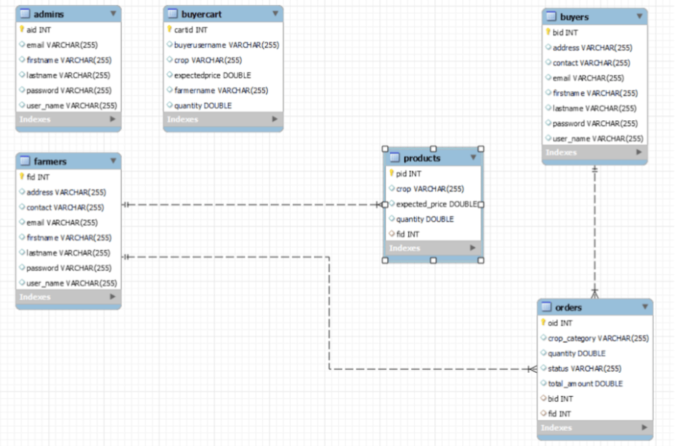
Class Diagram

Slide 10
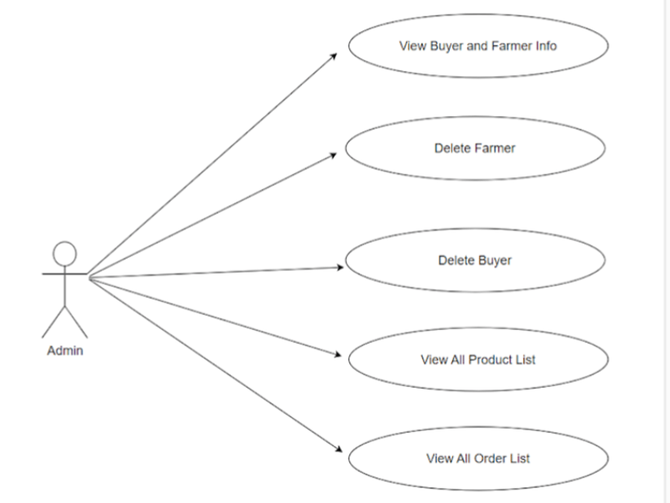
Admin Use-Case Diagram

Slide 11
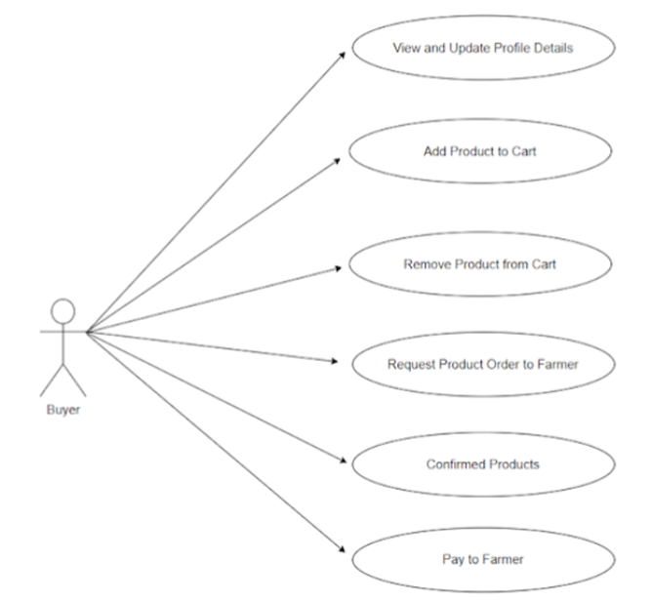
Buyer Use-Case Diagram

Slide 12
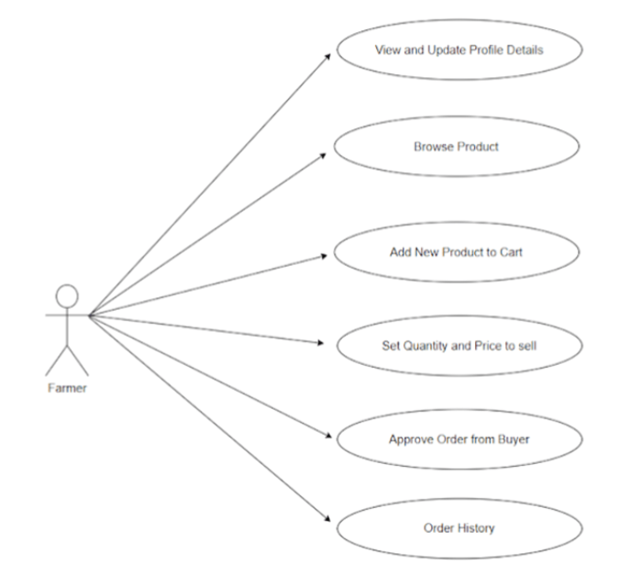
Farmer Use-Case Diagram

Slide 13
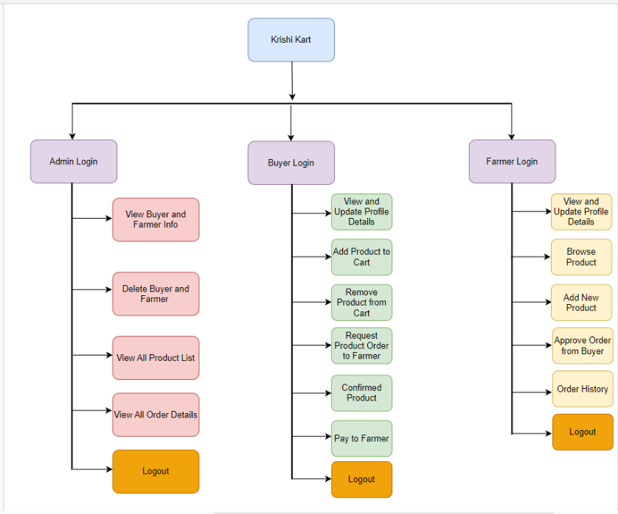
Functional Decomposition Diagram

Slide 14
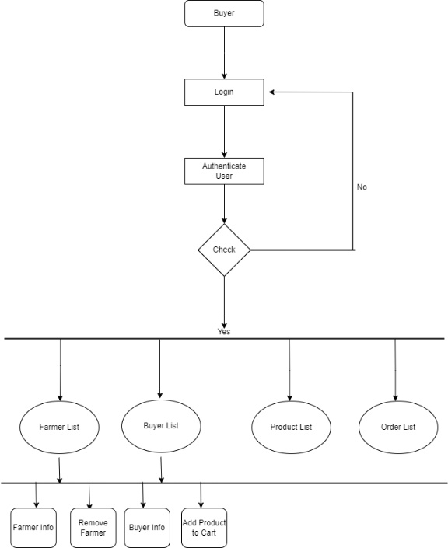
Admin Activity Diagram

Slide 15
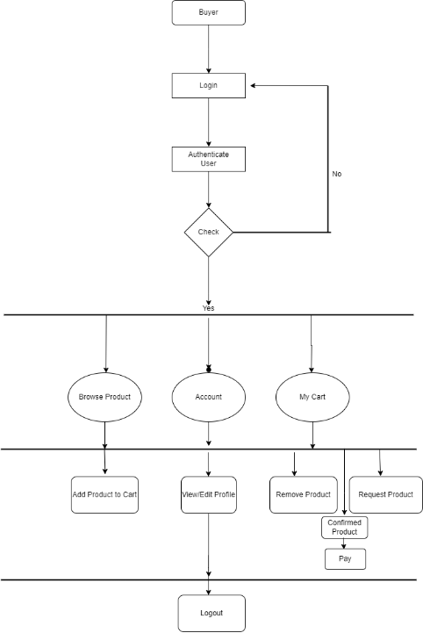
Buyer Activity Diagram

Slide 16
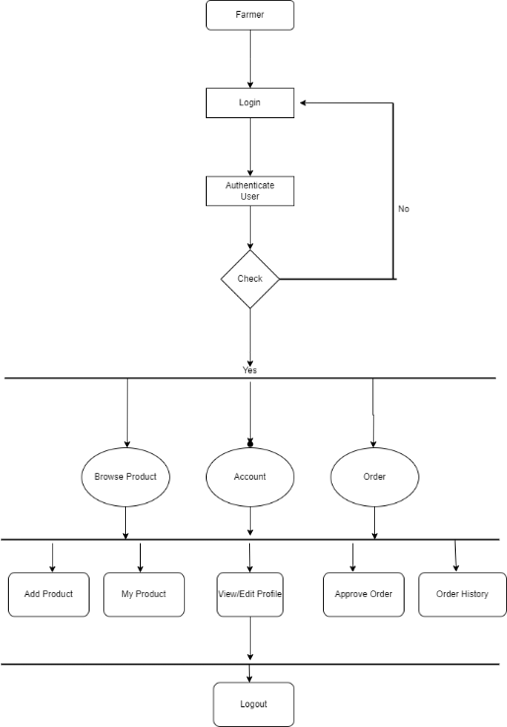
Farmer Activity Diagram

Slide 17
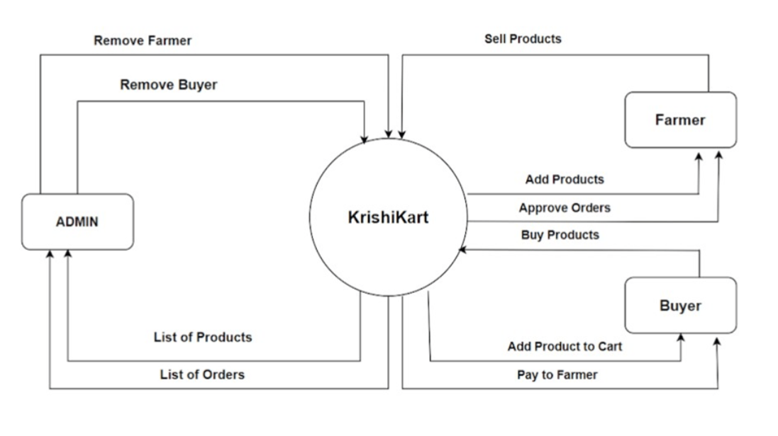
Zero Level Data Flow Diagram

Slide 18
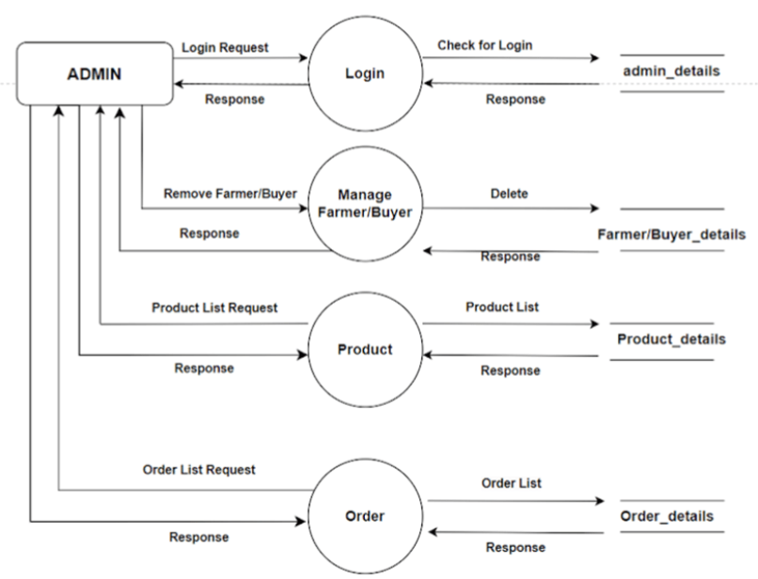
Admin First Level Data Flow Diagram

Slide 19
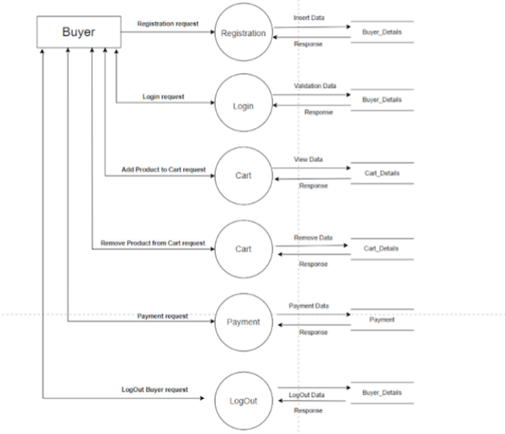
Buyer First Level Data Flow Diagram

Slide 20
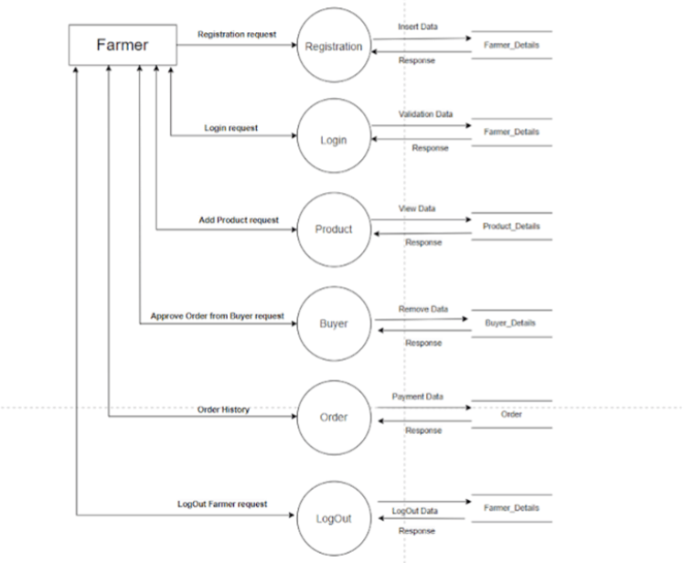
Farmer First Level Data Flow Diagram

Slide 21
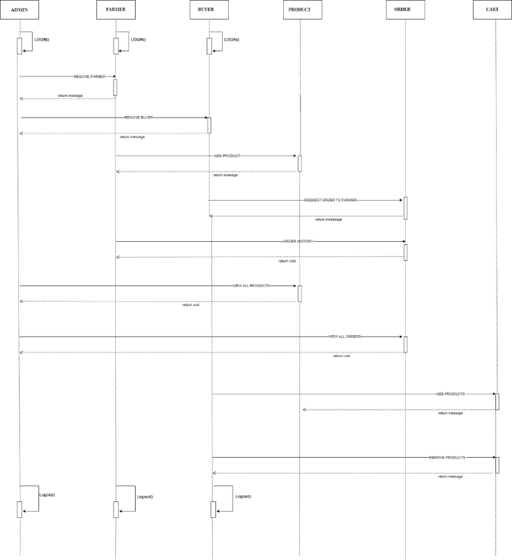
Sequence Diagram

Slide 22
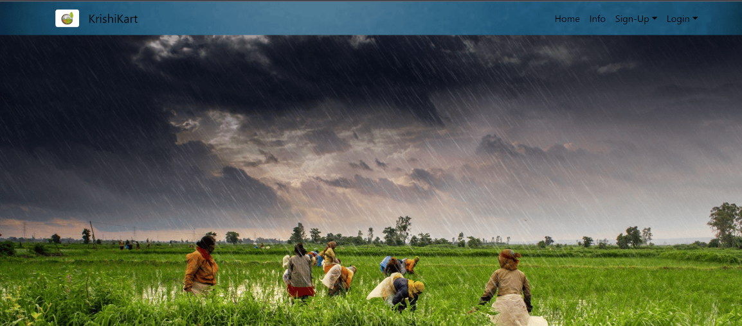
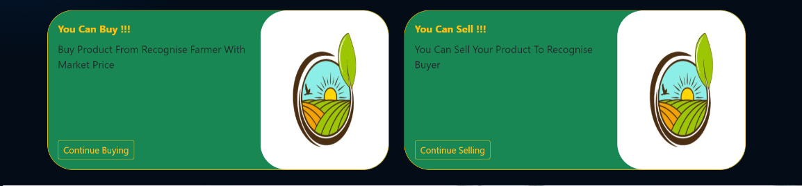
Homepage

Slide 23
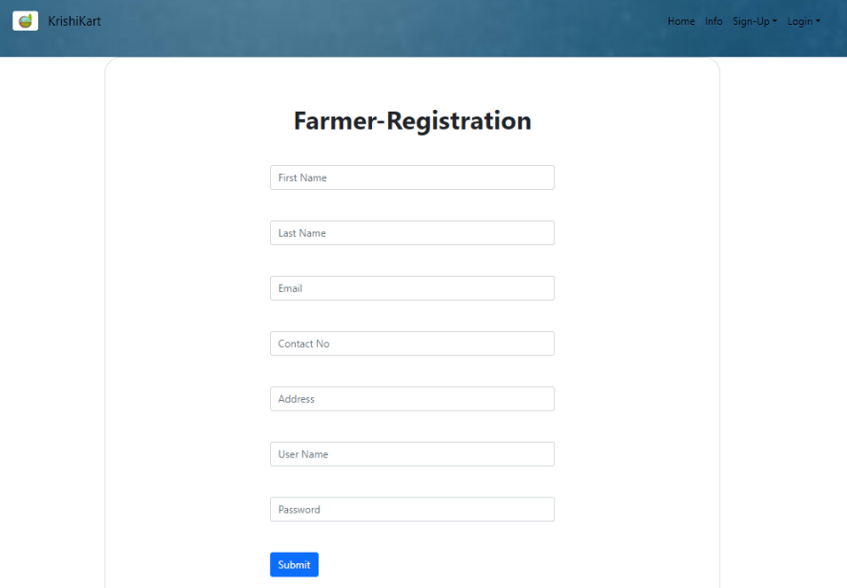
Sign-up page

Slide 24
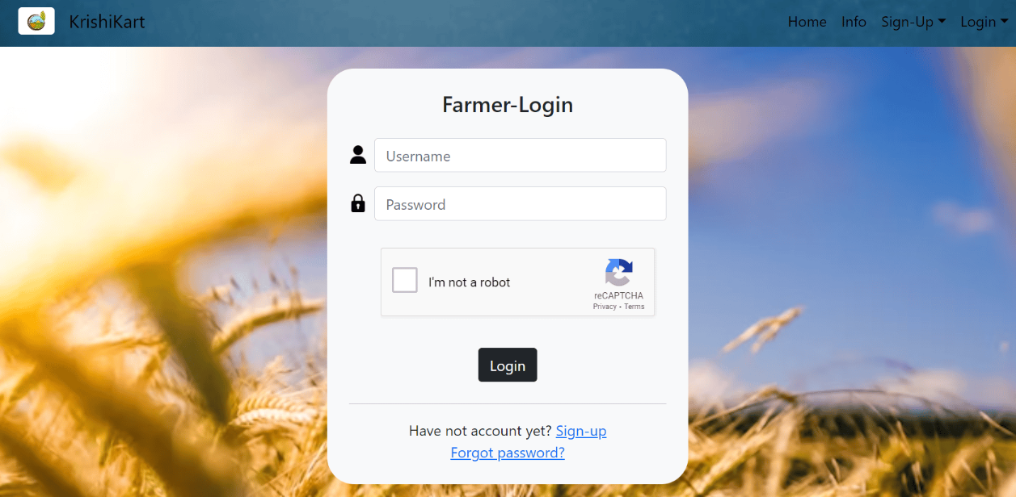
Login page

Slide 25
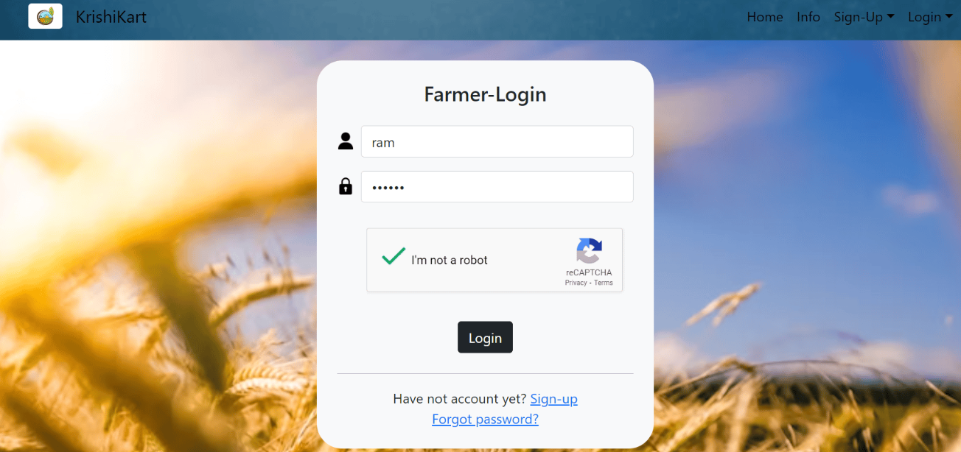
Enter Login details and click on login button

Slide 26
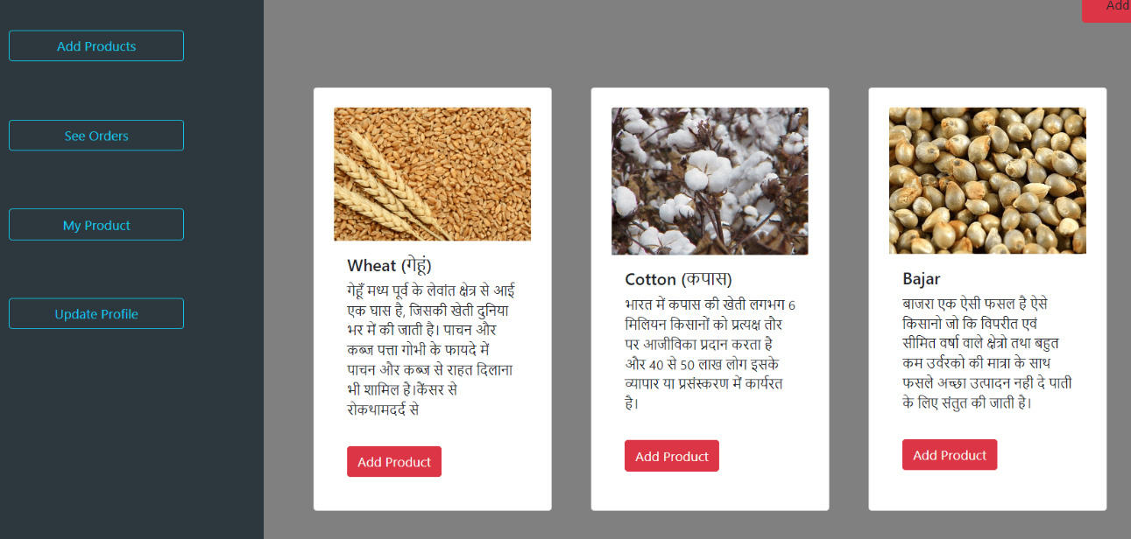
Click on add products to add product

Slide 27
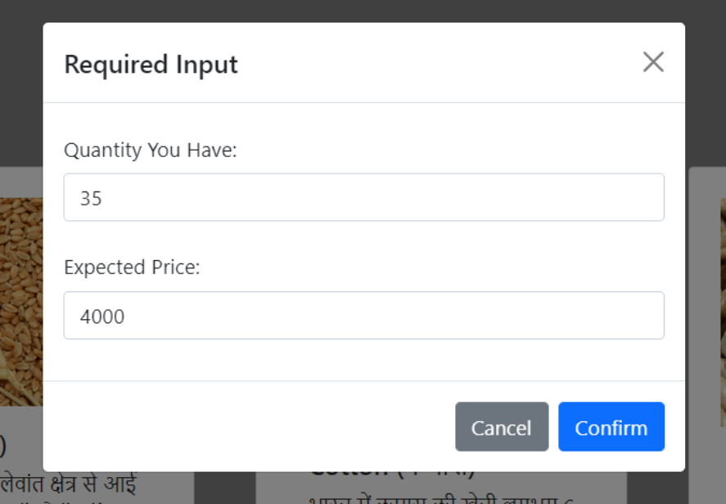
Enter details of product

Slide 28
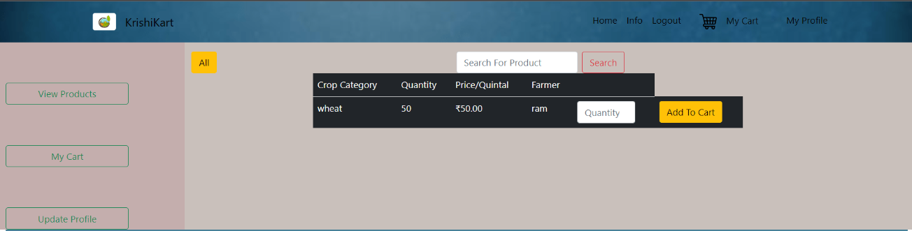
Buyer will see listed products

Slide 29
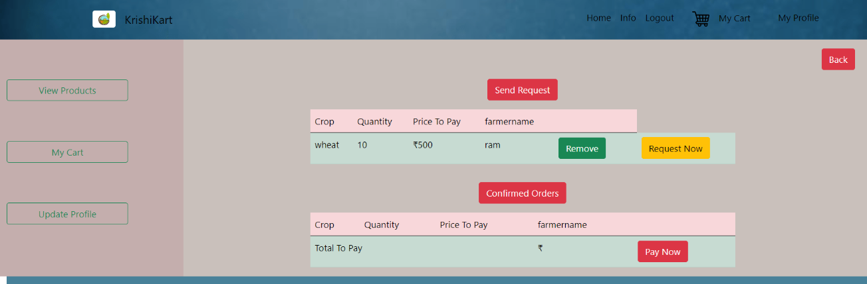
Buyer cart : buyer will request the product to farmer

Slide 30
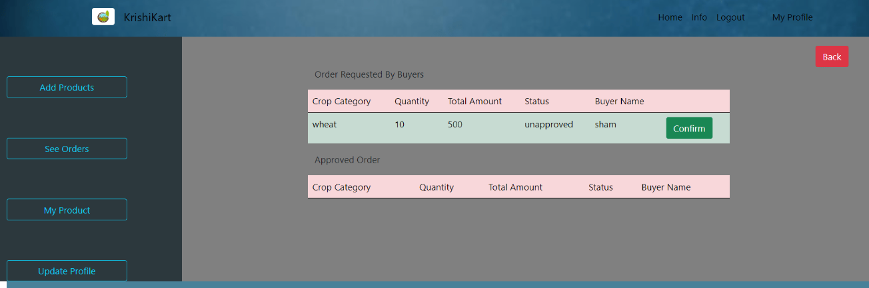
Farmer will approve order

Slide 31
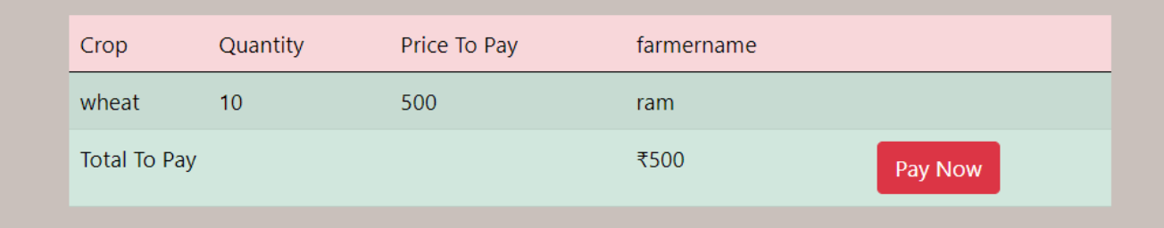
Buyer will pay

Slide 32
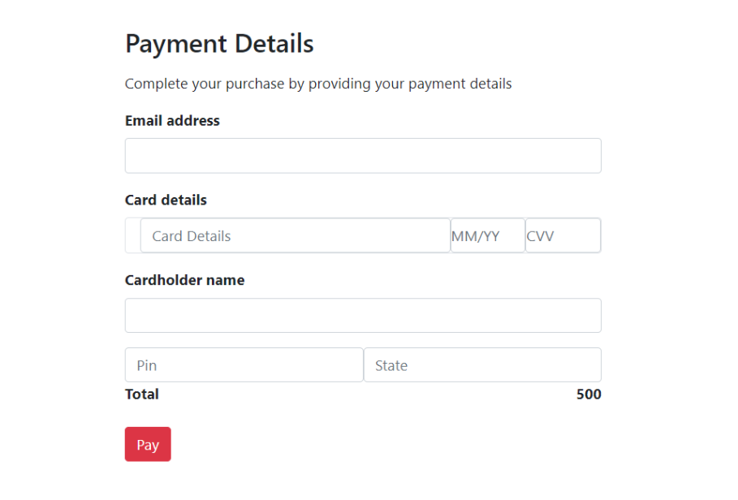
Buyer will proceed for checkout

Slide 33
References
•Stack Overflow - https://stackoverflow.com/
•Java docs -https://docs.oracle.com/javase/8/docs/technotes/tools/windows/javadoc.html
•Javatpoint - https://www.javatpoint.com/
•Spring Boot Docs - https://docs.spring.io/spring-boot/docs/current/reference/htmlsingle/
•ReactJS Docs - https://reactjs.org/docs/getting-started.html
•Scribe - https://scribehow.com/

